Slide 1

BCA ENERGY PROVISIONS
Notes:
Introduction:
When the BCA energy efficiency provisions for houses in Western Australia are introduced on the 1 July 2003 it will affect the way new homes and extensions are designed and built.
Energy efficiency is important and when HIA saw the draft energy provisions where unworkable, onerous, unnecessarily complex and expansive it swung into action. HIA members made a staggering 450 submissions, over half the total, the major of those came from WA.
The Energy Provisions now reflects the ABCB objective of delivering minimum cost-effective measures.
HIA is committed to helping all members make a smooth transition to the new BCA energy provisions and has online training available, facts sheets as well as these training sessions.

Slide 2
OUTLINE OF PRESENTATION
1. Climate Zones
2. Energy Efficiency Issues
3. Administrative Changes In The BCA
4. Deemed to Satisfy Provisions
5. Energy Rating Software
6. Examples Of Energy Efficient Homes
Notes:
The presentation will cover:
climate zones
Why have energy efficiency provisions
administrative changes in the BCA
five building elements that have been targeted
energy rating software
some examples of energy efficient homes.

Slide 3
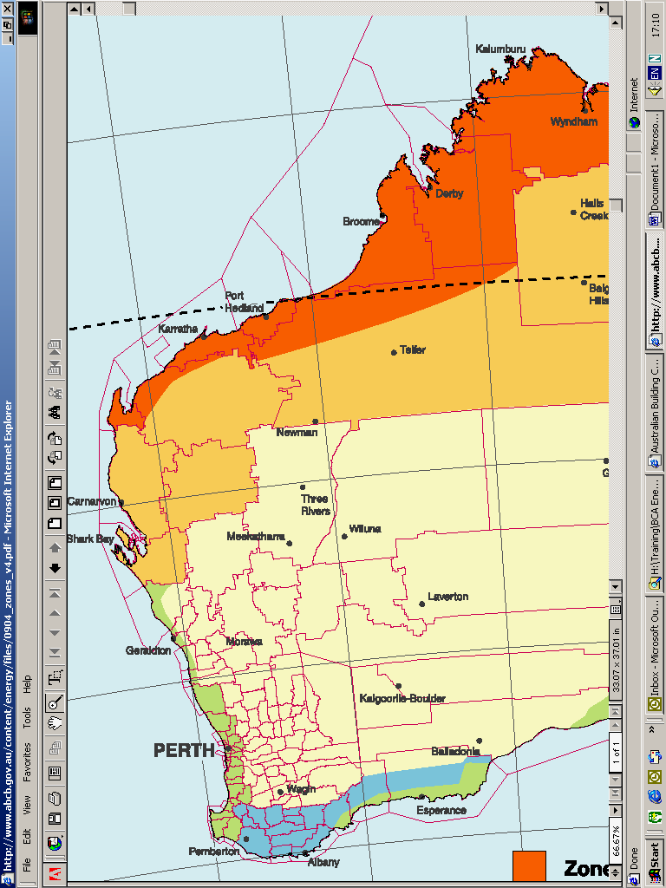
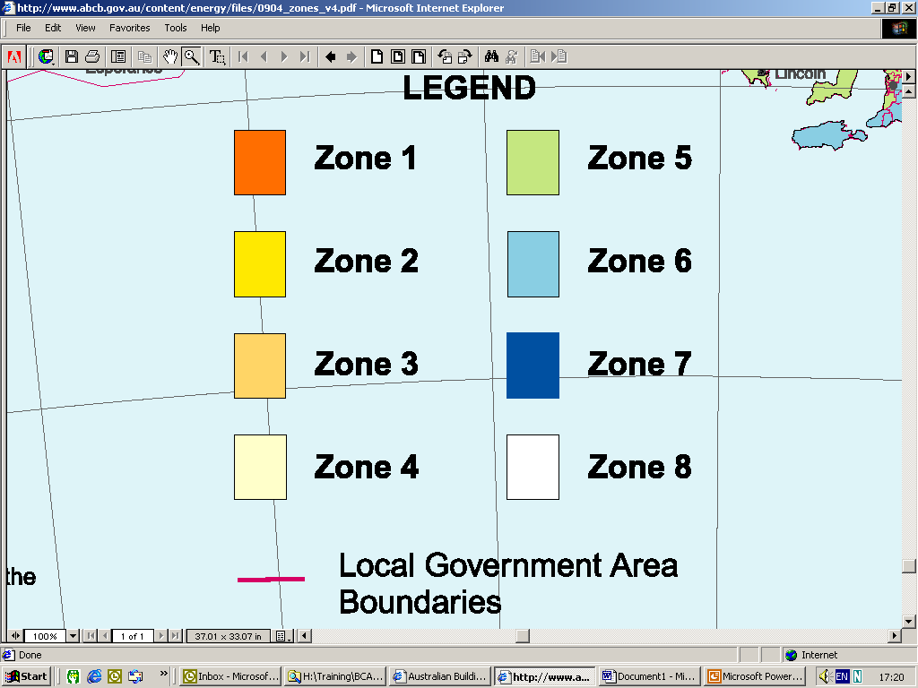
Part 1.1 INTERPRETATION
CLIMATE ZONES
Notes:
Climate Zones
Western Australia has five climate zones designated:
Zone 1 – High humidity summer, warm winter
Zone 3 – Hot dry summer, warm winter
Zone 4 – Hot dry summer, cool winter
Zone 5 – Warm Temperate
Zone 6 – Mild Temperate
The areas are defined on local government boundaries which are a arbitrary but seemingly the best way to define the requirements.

Slide 4
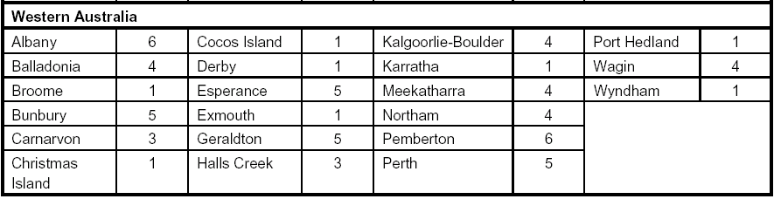
Table 1.1.2 - EXAMPLE OF CLIMATE ZONES
Notes:
Climate Zones
As a guide the following list shows the Climate Zones of the major Cities and towns in Western Australia.

Slide 5
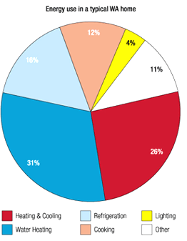
ENERGY USE - TYPICAL WA HOME
Notes:
In addition to providing a comfortable living environment with minimal or no requirement for air-conditioning and heating, an energy-efficient home has to minimise the energy consumption needed for heating, room heating, lighting and other basic household services.
This is the first step in improving the energy efficiency of Australian houses ( the provisions will be reviewed, the same as any other BCA requirement and they will be modified in the future to meet changing conditions and community expectations.
Just to give you some idea of the distribution of energy consumed in an average West Australian home, the biggest consumer is hot water at 31% next is space heating and cooling at 26%. These two areas therefore are naturally to be focused on for energy savings. Hot water is not to be regulated in the BCA but there are new requirement in AS 3500 which your plumber will have to comply with and charge accordingly.

Slide 6
Part 2.6 BCA PERFORMANCE REQUIREMENTS
P2.6.1 Building
A building must have, to the degree necessary, a level of thermal performance to facilitate the efficient use of energy for artificial heating and cooling
P2.6.2 Services
A building's domestic services, including any associated distribution system and components must have features that, to the degree necessary, facilitate the efficient use of energy
Notes:
Energy Savings – BCA Requirements
The BCA has set out how to achieve the first step in achieving energy efficiency in the new housing and additions. The way houses are designed and constructed will obviously change and will continue to change over time as energy efficiency requirements are accepted and refined.
Mandatory Requirements
The mandatory performance requirements of the BCA for Class 1 buildings and Class 10a buildings that are artificially heated and cooled are :
1. that these buildings must be constructed in a manner that allow the efficient use of energy for artificial heating and cooling, and
2. the buildings’ domestic services must allow the efficient use of energy.

Slide 7
V2.6 - VERIFICATION METHODS
1. deemed to satisfy
2. computer analysis
3. performance route
following the deemed to satisfy provisions guarantees compliance
Notes:
Verification
These BCA Energy Provisions can be achieved in a number of ways:
Follow the deemed-to-satisfy provisions, detailed in the BCA, which are acceptable construction practices and guarantees compliance; or
one alternative Solution is to have an computer energy rating analysis carried out on the design. The resultant annual predicted energy load in Climate Zones 4, 5 and 6 must be at least equal to a 4 star rating for Climate Zones 1 & 3 at least equal to a 3.5 star rating; or
A combination of 1 and 2 can be utilised; or
Go the performance route which is about proving what you want to do meets the performance requirements as stated
Buildings constructed in accordance with the Deemed-to-Satisfy Provisions of the BCA for West Australia ie, for Climate Zones 4,5 and 6, are considered to achieve equivalent thermal performance to a 4 or 3.5 star rating using a recognised computer software program.
Following the deemed to satisfy provisions guarantees compliance.

Slide 8
Part 3.12 ELEMENTS TO BE REGULATED
Building Fabric
External Glazing
Building Sealing
Air Movement
Services
Applies to Class 1 buildings and Class 10a buildings with a conditioned space
Notes:
The BCA has detailed a way to achieve compliance. This is the prescriptive approach or the deemed to satisfy provisions.
There are five aspects of house construction to be regulated to achieve the mandatory requirements of the BCA:
2. Building fabric
3. External glazing
4 Building sealing
5. Air movement, and
6. Services

Slide 9
Part 3.12.1 BUILDING FABRIC
1. Building Fabric - Insulation
2. Roofs
3. Roof Lights
4. External Walls
5. Floors
6. Attached class 10a buildings
Notes:
Building fabric requirements apply to a Class 1 building, and a Class 10a building with a conditioned space
Building fabric construction includes:
Building fabric - insulation
Roofs
Roof lights
External walls
Floors
Attached Class 10a buildings

Slide 10
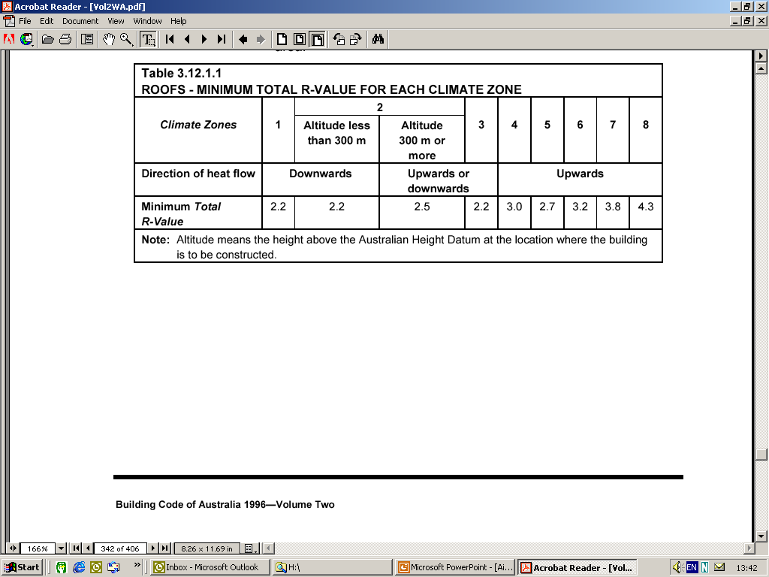
3.12.1.2 - ROOFS
INSULATE ROOF, CEILING OR BOTH
Notes:
Design considerations
For housing, roof thermal resistance will always be a high priority in temperate areas to reduce heat loss in the winter.
There are principally two ways to insulate the roof, depending on whether the roof space is to be useable space or not - Roof Insulation and Ceiling Insulation.
Typically roof Insulation employs reflective foil to control radiant heat.
Ceiling Insulation is typically bulk in nature and controls conducted & confvected heat.
Reflective foil insulation only works if it is mounted adjacent to an air space, with the shiny reflective side facing into the air space.
The reflective surface must not collect dust or dirt . For this reason, the foil should be mounted with the reflective side facing downwards into a roof space, or inside enclosed walls.
The rate of heat conduction through a roof space varies in summer and winter.
The resistance to heat flow down is more than for heat flow up so roofs incorporating air space must be assigned different R-values depending on whether summer or winter conditions exist.
Because hot air rises, the roof space will impede downward heat transmission in summer more effectively than upward heat transmission in winter.
In Climate Zones 3,4,5 & 6 the R value of the roof needs to prevent the upwards transmission of heat (keep the heat in). In Climate Zones 1&3 it must prevent the downward transmission of heat.

Slide 11
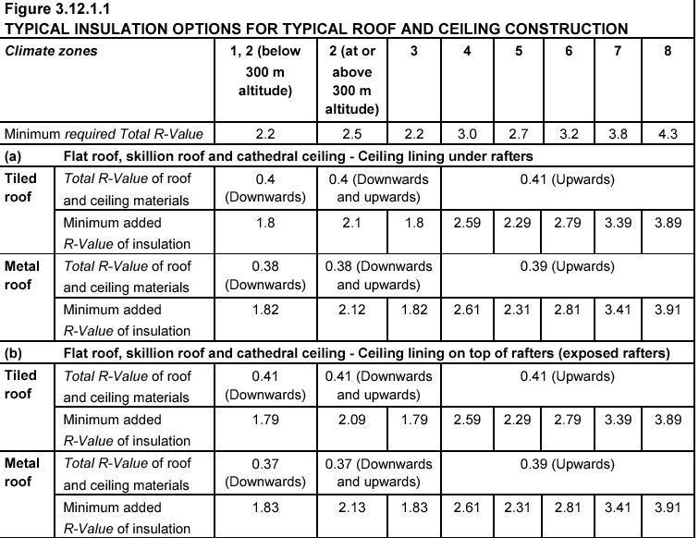
Notes:
ROOFS - BCA Requirements
Generally roofs must achieve a specified total R-Value depending on the climate zone
Roofs –
climate zone 1 achieve a Total R-Value of 2.2 downwards or have solar absorbent factor less than .55
climate zone 3 achieve a Total R-Value of 2.2 upwards or downwards,
or have solar absorbent factor less than .55
climate zone 4 achieve a Total R-Value of 3.0 upwards,
climate zone 5 achieve a Total R-Value of 2.7 upwards,
climate zone 6 achieve a Total R-Value of 3.2 upwards.
A roof, or roof and associated ceiling, is deemed to have the Total R-Value required the zone if it complies with the appropriate construction in the table.

Slide 12
ROOF - ADDED INSULATION
Zone 1. add total of R2.0
Zone 3. add total of R2.5
Zone 4. add total of R3.0
Zone 5. add total of R2.5
Zone 6. add total of R3.0
Notes:
A roof must-
(a) achieve the minimum Total R-Value specified in Table 3.12.1.1; or
(b) in climate zones 1 and 3 for a pitched roof with a flat ceiling have–
(i) a solar absorptance value of not more than 0.55; and
(ii) RBM installed below the roof; and
(iii) a roof space ventilated by-
(A) gable vents, ridge vents, eaves vents, roof vents or the like that-
(aa) are evenly distributed to allow an unobstructed flow of air; b and
(bb) are located to ensure, where practicable, there are no dead air spaces; and
(cc) have an aggregate fixed open area of not less than 1.0% of the ceiling area; or
(B) not less than 2 wind-driven roof ventilators having an aggregate opening area of not less than 0.14 m
2 in conjunction with gable vents, ridge vents, eaves vents, roof vents or the like having an aggregate fixed open area of not less than 0.2% of the ceiling area.

Slide 13
3.12.1.3 - ROOF LIGHTS
Roof lights are regulated for habitable rooms or an interconnecting space.
Area of roof lights to floor area of room
Area of roof lights to total floor area
Length of roof light shaft
Controlled on solar /heat specifications
Notes:
Design Considerations
Roofs lights serving a habitable room or similar are regulated in consideration of:
area of roof lights to floor area of room
area of roof lights to total floor area
length of roof light shaft
The control measures relate to the Solar Heat Gain Co-efficient (SHGC) and the Total U-Value of the roof lights. The U value gives the rate of heat transfer through a particular building element of 1sqm with temperature difference across it of 1K.

Slide 14
3.12.1.4 - EXTERNAL WALLS MUST
achieve the Total R-Value specified in Table 3.12.1.3; or
(ii) in climate zones 1, 2 and 3, be shaded by a verandah etc, having a horizontal projection of not less than one quarter of the overall height of the wall; or
(iii) in climate zones 4 and 5, achieve a density of not less than
220 kg/m²; or
(iv) in climate zone 6, achieve a density of not less than 220 kg/m² and be constructed on a flooring system that is in direct contact with the ground
(v) in climate zones 6, 7 and 8, achieve a surface density of not less than 220 kg/m² and incorporate insulation with an R-Value of not less than 1.
Notes:
The external walls are important in term of overall building heat loss.
To achieve comfortable conditions in cooler climates, walls need to be insulated to slow down the exchange of heat through the perimeter structure
The brick veneer construction system, the second most common in Australia (after the full timber frame) can still be considered as a lightweight system.
Although the thermal mass of the brick veneer is outside, the thermal behaviour and other inherent characteristics of the lightweight house, the positioning of the mass on the outside of the building frame results in the house's 'lightweight' behaviour internally.

Slide 15
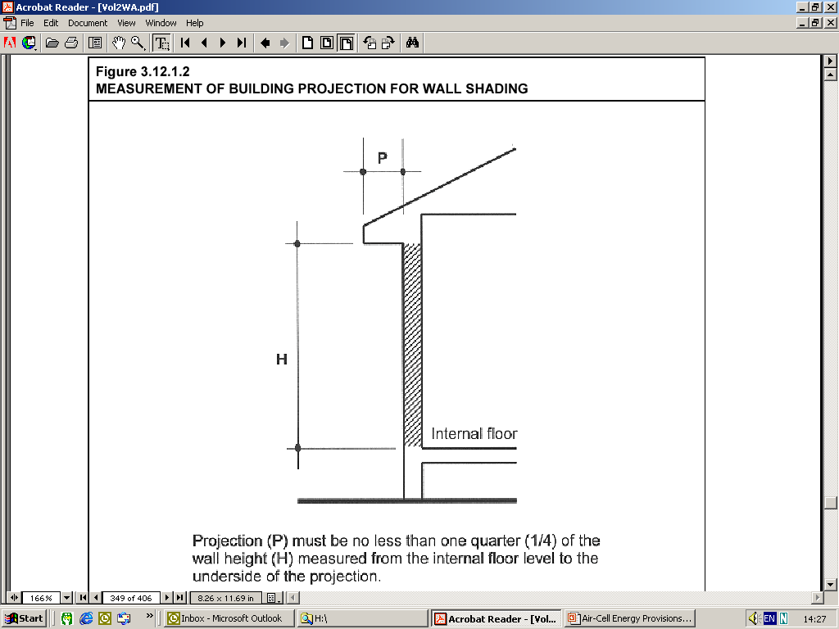
Notes:
Climate Zones 1 & 3 The external wall must –
achieve the minimum Total R-Value specified in Table 3.12.1.3 for the relevant climate zone; or
(ii) in climate zones 1, 2 and 3 for each storey of the building, be shaded by a verandah, balcony, eaves, carport or the like, including any attached guttering-
having a horizontal projection from the external face of the building to the outer edge of the projection of not less than one quarter of the overall height of the wall; and
(B) with the overall height of the wall measured vertically from the
internal floor level in accordance with Figure 3.12.1.2; or

Slide 16
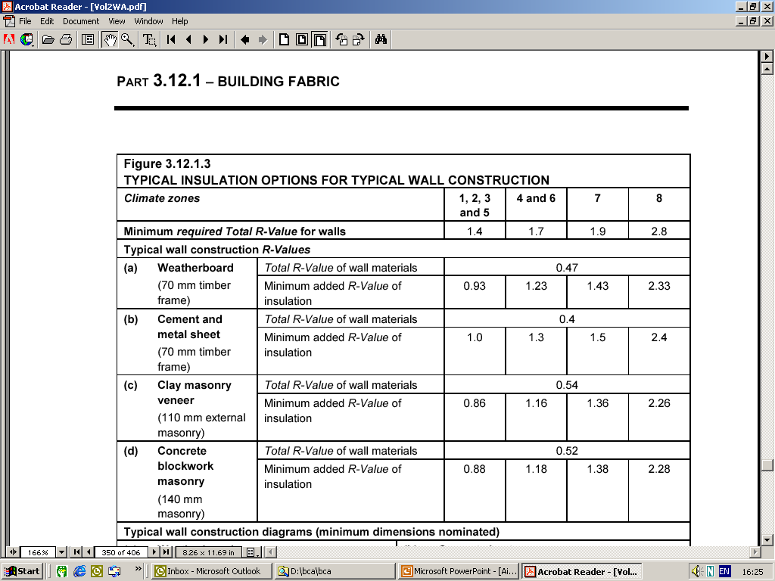
Notes:
However, the above requirements do not apply to opaque non-glazed openings in external walls such as garage doors, shutters etc
A wall in climate Zones 4 & 6 and 5 is deemed to have the Total R-Value of R1.7 and R 1.4 respectively if it complies with the appropriate construction as described in the table

Slide 17
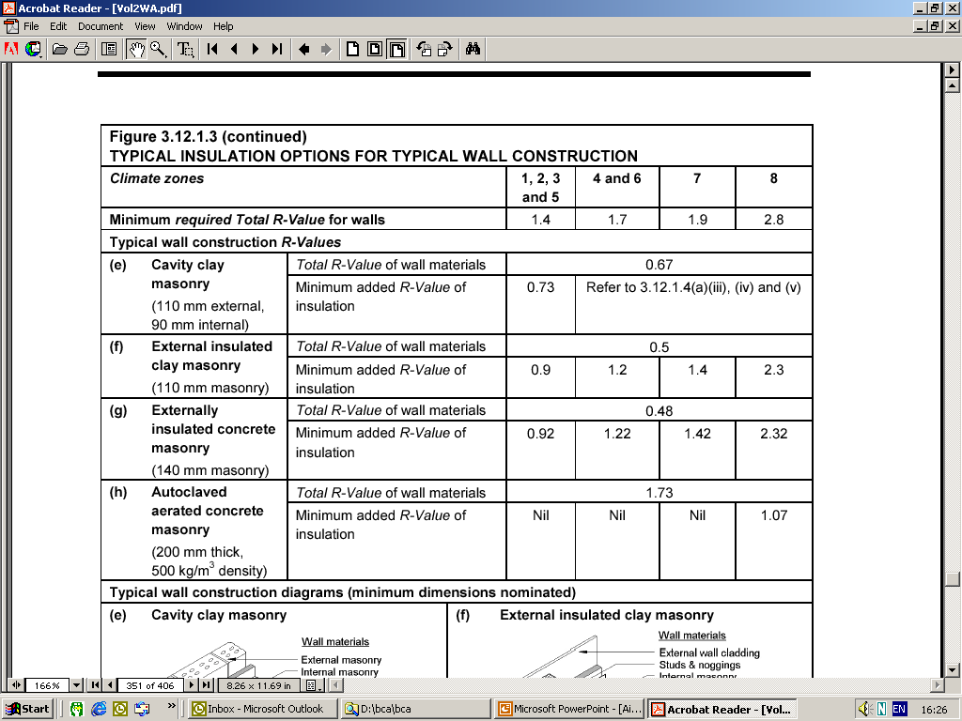

Slide 18
WALL - ADDED INSULATION
Zone 1. add total of R1.0
Zone 3. add total of R1.0
Zone 4. add total of R1.5
Zone 5. add total of R1.0
Zone 6. add total of R1.5

Slide 19
3.12.1.5 - FLOORS
A heated slab on ground in any zone or a suspended unenclosed floor in zone 6 requires perimeter insulation
1. R value of not less than 1.0
2. Be water resistant
3. Be continuous to a depth of 300mm or the full extent of the vertical edge of the concrete
Under tile or in screed heating is not an in-slab system
Notes:
A concrete slab-on-ground with an in-slab heating system must have insulation, as specified, around the vertical edge of its perimeter
have an R-Value of not less than R1.0; and
be water resistant; and
be continuous from the adjacent finished surface level
to a depth of 300 mm; or
for the full extent of the vertical edge of the concrete slab-on-ground.
An under-tile or in-screed heating system in a bathroom, amenity area or the like, is not considered to be an in-slab system.
.

Slide 20
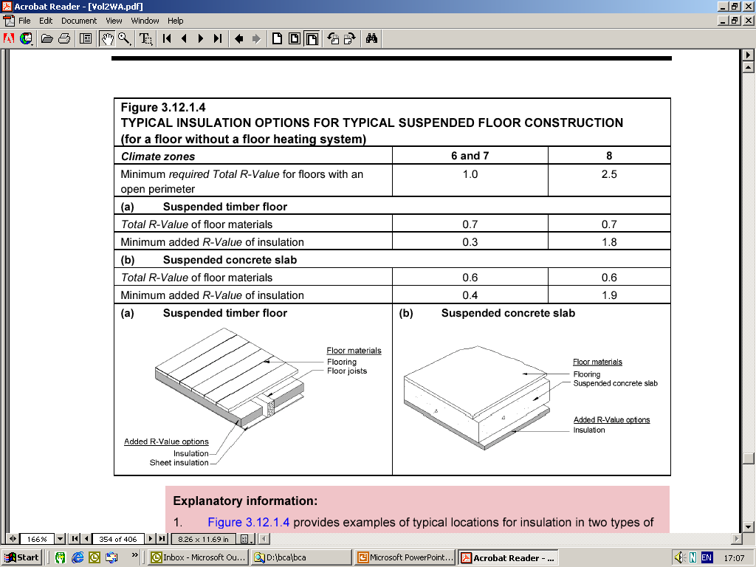
Notes:
Floors - Design Considerations.
There are two main floor construction systems to be considered for energy efficiency treatment - suspended floors or slab-on-ground.
A lightweight house with an open suspended floor behaves quite differently, thermally, from one with an enclosed suspended floor (i.e. clad in brick). The latter house's thermal behaviour is in fact very similar to the common slab-on-ground construction.
The thermal assessment of floors is more complex than that for walls or roofs because of variables such as ground temperature and soil moisture.
BCA Requirements - Building Fabric - Floors Zone 6 (NONE FOR 4 & 5)
In climate zone 6 suspended floor with an unenclosed perimeter must have a Total R-Value of not less than R1.
A suspended floor with a heated slab must be insulated at the perimeter and underneath the slab with insulation having a minimum R-Value of not less than R1.0.
An unenclosed perimeter means that the sub-floor is not enclosed by ground-to-floor cladding such as masonry or cement sheet. The ground-to-floor cladding can have the required sub-floor vents and still be considered enclosed.

Slide 21
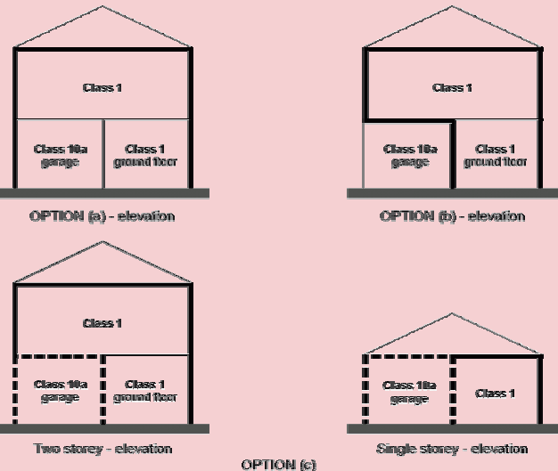
3.1.1.6 - ATTACHED CLASS 10A BUILDINGS
Notes:
Explanatory information: The attachment of a Class 10a building, such as a garage, glasshouse, solarium, pool enclosure or the like should not compromise the thermal performance of the Class 1 building. In addition, the Class 10a building may be insulated or have inherent insulating characteristics that assist the Class 1 building achieve the required thermal performance. The following are examples of a Class 1 building with an attached Class 10a garage.
In (a), the thermal performance required for the Class 1 building may be achieved by the outside walls and floor of the Class 10a garage.
In (b), the thermal performance required for the Class 1 building may be achieved by the walls and floor of the Class 1 building as if the Class 10a garage is an under floor space with an enclosed perimiter.
In (c), the thermal performance required by the internal and external elements of the Class 10a garage, if added along all heat flow paths, may be achieved by the thermal performance required for the walls and floor of the two storey Class 1 building example, or the walls and roof of the single storey Class 1 example.
In English: (a) the garage is enclosed , don’t worry about the door, it has been too hard to deal with.
(b) any walls surrounding the garage space has to be full on thermal performance.
(c) You can add the outer wall and the inner wall’s performance to come up with the required performance figures , this includes the ceiling.

Slide 22
3.12.2 - EXTERNAL GLAZING
Regulated by limiting the % of total window glazing to the total floor area of the storey.
windows do not include roof lights
glazing in the north orientations may be halved when calculating the effective glazing
% effective glazing also varies depending on the climate zone, the type of glazing, the thickness, the framing material and the horizontal projection of the shading projection.
Notes:
External Glazing – BCA Requirements
The effective glazing ( ie % of total window glazing area to total floor area)is limited for each storey of the building
Windows do not include roof lights
Glazing in north walls is only taken at 0.5 times the calculated area
The % limitation is generally increased if the external wall is shaded
The % limitation in Table 3.12.2.1 also varies depending on:
the climate zone
the type of glazing
thickness of glazing, and
the material used to frame the glazing
the horizontal dimension of a shading projection
A window energy rating scheme (WERS) was developed in 1996 which applies the 5-Star rating system to residential windows. Windows carry a label outlining the energy rating or cooling based on heating or cooling requirements.

Slide 23
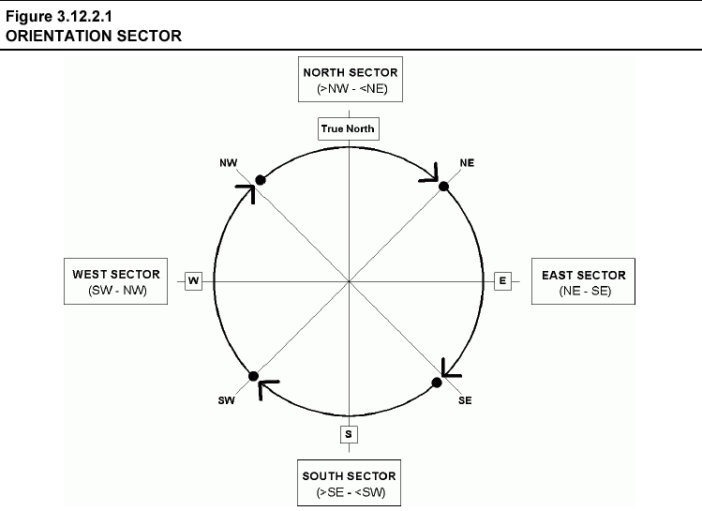
Notes:
A building wall, including the glazing it contains, is considered to face north if it faces any direction in the north orientation sector of Figure 3.12.2.1. The orientations of other walls, including the glazing they contain, are determined in a similar way.
Orientation sectors are based on true N (not magnetic N) and are as follows:
North sector between north west (>315⁰) and north east (< 45⁰).
East sector between north east (45 ⁰) and south east (135 ⁰ ).
South sector between south east (>135 ⁰ ) and south west (<225 ⁰ ).
West sector is between south west (225 ⁰ ) and north west (315 ⁰ ).
Magnetic north is not usually in the same direction as geographic north so if a compass is used a correction must be made. The variation of true north is about 12 degrees East and thus add 12 degrees to the west of the compass north to get true north.

Slide 24
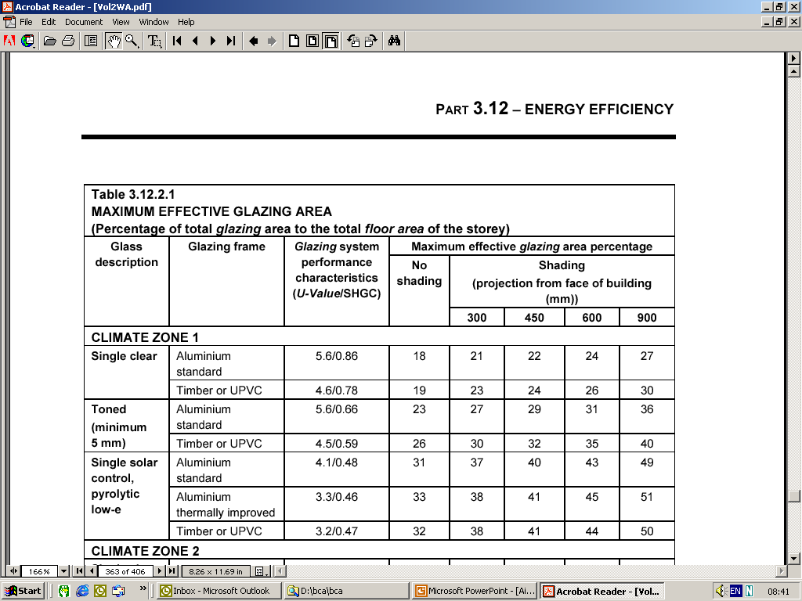
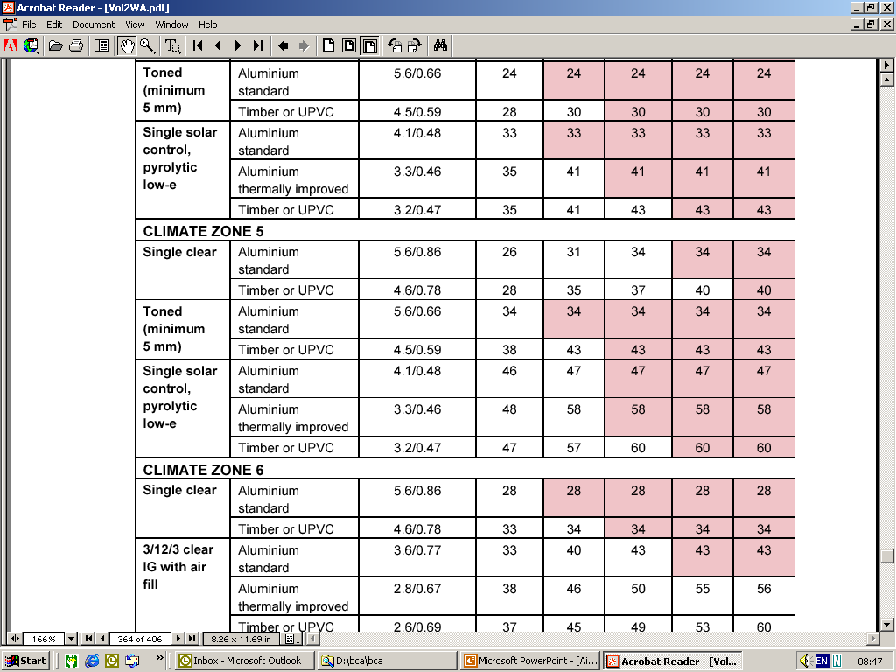

Slide 25
Part 3.1.2.2 - SHADING
If shading projections are used to achieve a greater % of window glazing area:
1. its location is specified
2. it must be a permanent feature such as a balcony, eaves, shading hood etc
3. its horizontal dimensions must comply
4. its effective performance and operation if adjustable are regulated
Notes:
Shading – BCA Requirements
Generally if shading is used to achieve a greater % of window glazing area
its’ location is specified
it must be a permanent feature such as a balcony, eaves, shading hood etc or a Class 10 building such as a carport or the like; and be no less than the required projection distance from the face of the building.
its’ horizontal dimensions must be comply
its’ effective performance and operation (if adjustable) are regulated.

Slide 26
Part 3.12.2.2 - SHADING
shading can be achieved by:
1. a shading projection
2. a shading device
3. combination of both
for example - eaves on two sides of a building and adjustable shading devices on the other two sides
Notes:
Shading
Shading is the offsetting of the unwanted effects of solar radiation by any device, structure or form, after consideration has been given to orientation and planning of the home.
In winter shade will prevent the use of solar heat for passive night heating and shade offers no heat retention qualities.
Shading can be achieved by a shading projection (refer to Figure 3.12.2.2), a shading device or a combination of both (refer to 3.12.2.2). For example - eaves on two sides of a building and adjustable shading devices on the other two sides.

Slide 27
Part 3.12.2.2 - SHADING
1.Shading of the south side is optional except for tropical locations (north of latitude 20 degrees south) where the shading must be provided to all sides of the building.
2. Shading devices can include fixed louvres, shading screens and other types of perforated or fixed angle slatted shades. However, such devices need to be designed for the climate and latitude.
3. Gutters can only be considered as providing shading if attached to a building projection such as a verandah, fixed canopy, eaves, shading hood, balcony or the like.
4. Shading devices can be either attached or located adjacent to the building.
5. Where the glazing area exceeds that in Table 3.12.2.1, the building including the glazing can be designed in accordance with the Verification Method V2.6.
Notes:
1. Shading to all climate zones south of latitude 20o must be provide to all but the south orientation sector.
2. Gutters can only be considered as providing shading if attached to a building projection such as a verandah, fixed canopy, eaves, shading hood, balcony or the like.
3. Shading devices can be either attached or located adjacent to the building in a manner so as to provide the required level of shading.
4. Where the glazing area exceeds that in Table 3.12.2.1, the building including the glazing can be designed in accordance with the Verification Method V2.6. This approach is also suitable for alternative glazing thermal performance systems such as applied films.
5. The alternative approach is also suitable for alternative glazing thermal performance systems such as applied films.

Slide 28
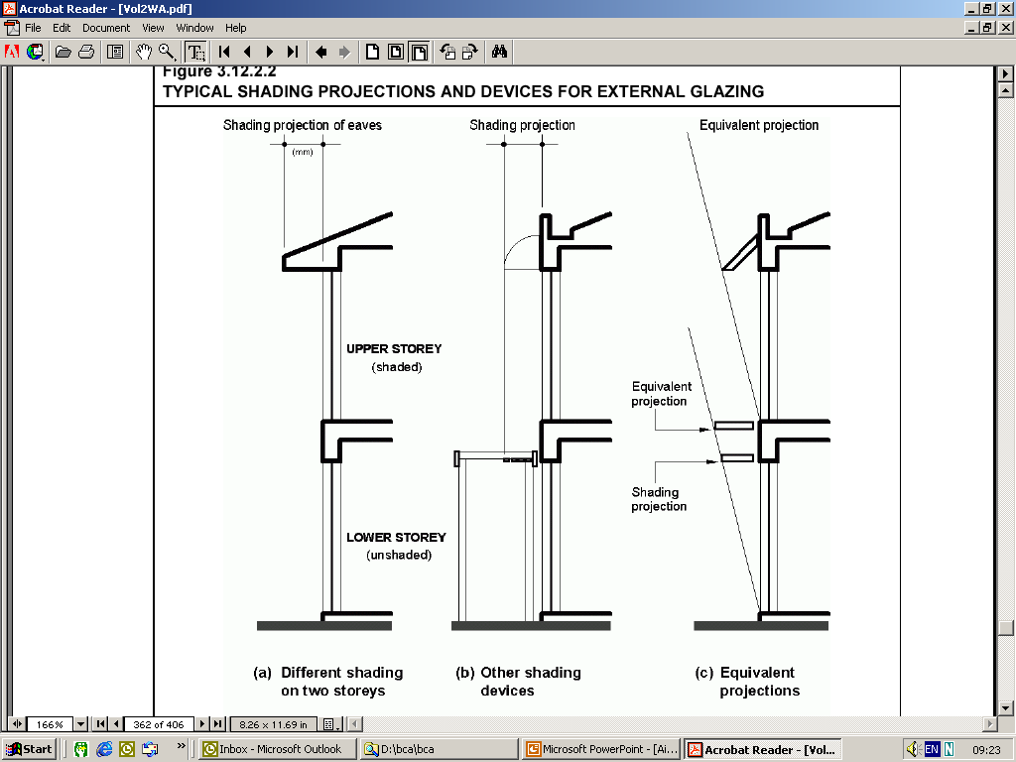
Notes:
Shading can be achieved by a shading projection

Slide 29
Part 3.12.3 BUILDING SEALING
A conditioned space or habitable rooms in climate zones 4 and 6 require:
1. damper flaps to chimneys and flues
2. roof lights must be sealed
3. external doors and windows must be sealed
4. exhaust fans must be fitted with a sealing device
5. roof, external walls,floors, windows,doors in external fabric must be fitted with internal linings that are close fitting, or sealed by chalking, skirtings, architraves, cornices or the like.
Notes:
Building Sealing

Slide 30
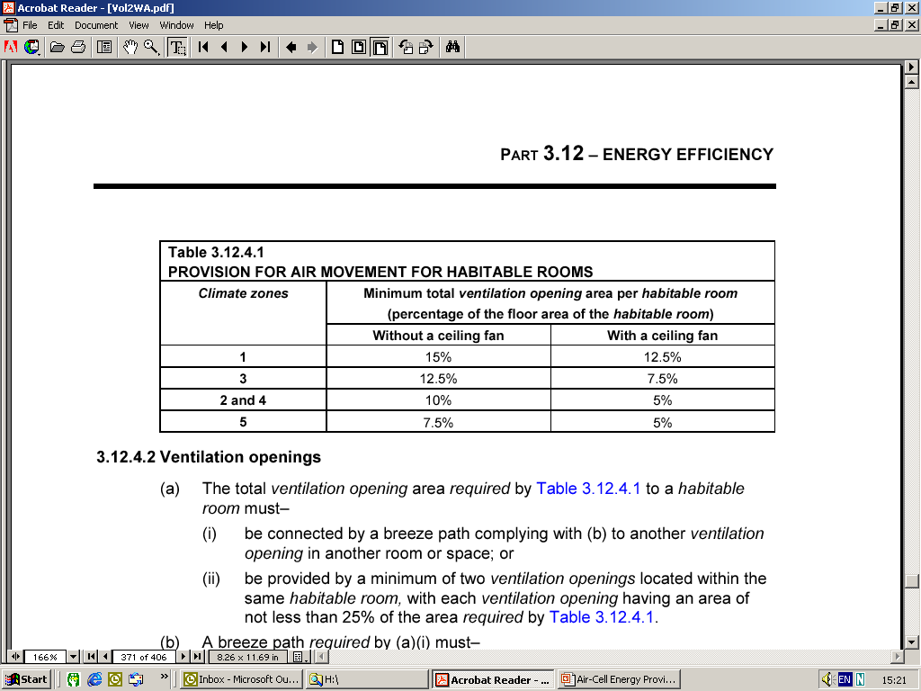
Part 3.12.4 - AIR MOVEMENT
Notes:
Air Movement
A habitable room must have provision for air movement in
climate zones 1, 3, 4 and 5, in accordance with Table 3.12.4.1 provided
(A) any required ventilation opening complies with 3.12.4.2 or,
where ventilation cannot be provided through an external wall, air movement may be provided in accordance with (b); and
(B) any required ceiling fan complies with 3.12.4.3; and

Slide 31
3.12.4.2 - VENTILATION OPENINGS
The total ventilation opening area required by Table 3.12.4.1 to a habitable room must–
be connected by a breeze path to another ventilation opening in another room or space;
or
(ii) be provided by a minimum of two ventilation openings located within the same habitable room, with each ventilation opening having an area of not less than 25% of the ventilation area required
Notes:
Ventilation openings
a) The total ventilation opening area required by Table 3.12.4.1 to a habitable room must–
(i) be connected by a breeze path complying with (b) to another ventilation opening in another room or space; or
(ii) be provided by a minimum of two ventilation openings located within the same habitable room, with each ventilation opening having an area of not less than 25% of the area required by Table 3.12.4.1.

Slide 32
3.12.4.2 (b) – BREEZE PATH
20m
1.5m²
2
1
1.5m²
Notes:
Ventilation openings should be designed to allow the interior of the building to take full advantage of any natural breeze. Careful consideration should be given to the type and location of openings to ensure optimum effect is achieved and that internal “dead air pockets” are avoided.
2. An opening may serve more than one breeze path.

Slide 33
Part 3.12.5 - SERVICES
3.12.5.1 Insulation of services
Thermal insulation for central heating water piping and heating and cooling ductwork must be–
(a) protected against the effects of weather and sunlight; and
(b) able to withstand the temperatures within the piping or ductwork.
Notes:
Generally services applying to Class 1 building, and a Class 10a building allow for the provisions for insulation of:
1. Central heating water piping
2. Heating and cooling ductwork

Slide 34
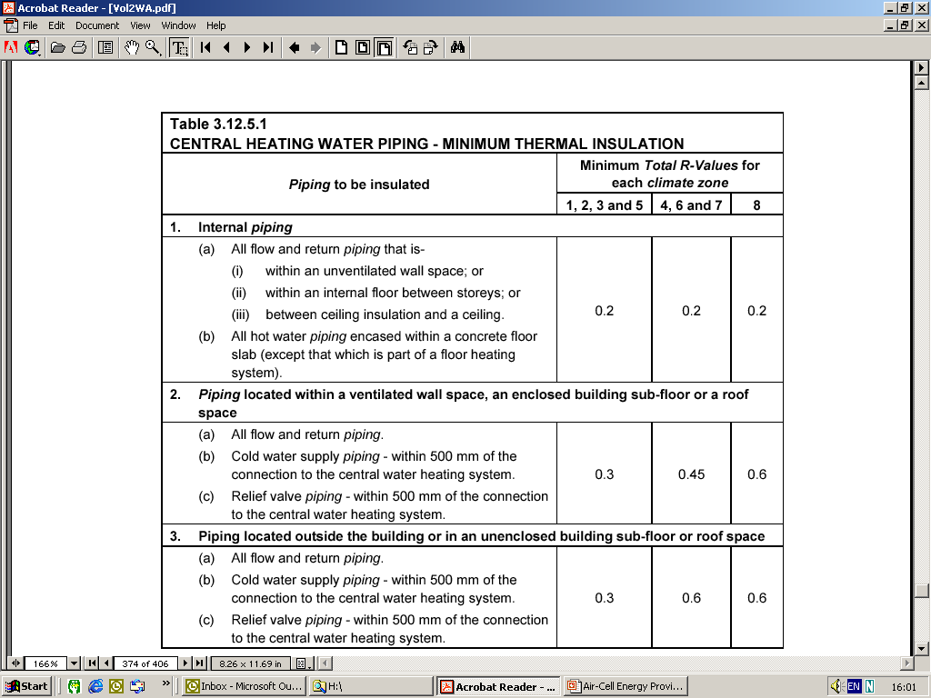
Notes:
BCA Requirements Services
A hot water supply system complying with Section 6A of AS/NZ 3500.4.2, or Section 3A of AS/NZ 3500.5 is acceptable, however a solar hot water supply system in climate zones 1 & 3 is not required to comply with these standards.
Thermal insulation for central heating water piping and heating and cooling ductwork must be:
1. protected against the effects of weather and sunlight, and
2. able to withstand the temperatures with the systems.
Central heating water piping not within a conditioned space must be insulated to achieve a minimum required R-Value as per Table 3.12.5.1

Slide 35
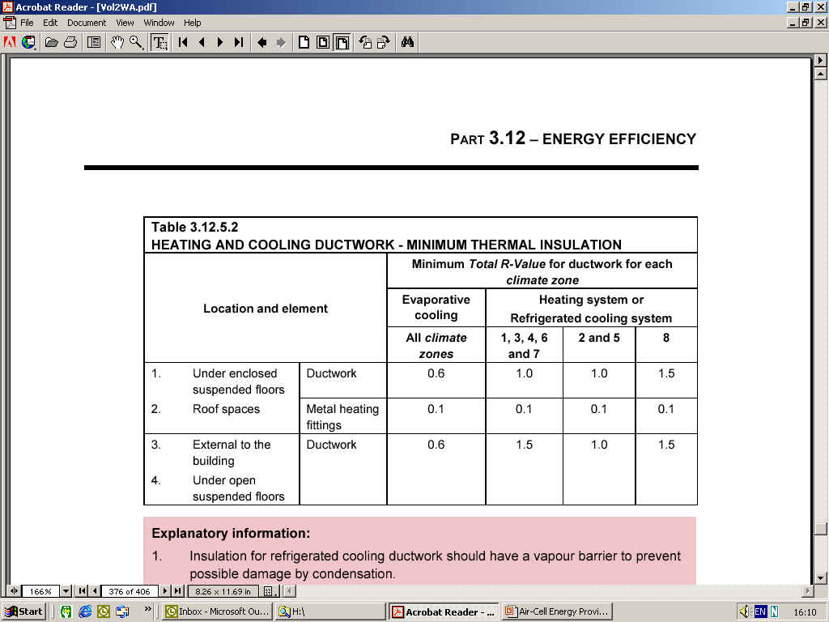
Notes:
BCA Requirements Services
Heating and Cooling ductwork
Heating and cooling ductwork and fittings must :
1. be insulated to achieve a required R-Value
2. use thermal insulation tested to AS 4508
3. be sealed as required against air loss
Duct insulation located under a suspended floor and in a roof space must be protected with a sealed system.
Explanatory information: Ductwork within a fully insulated building may still benefit from insulation particularly when the system is only operating for short periods. In some climate zones condensation may create problems with uninsulated ductwork and insulation should still be considered.

Slide 36
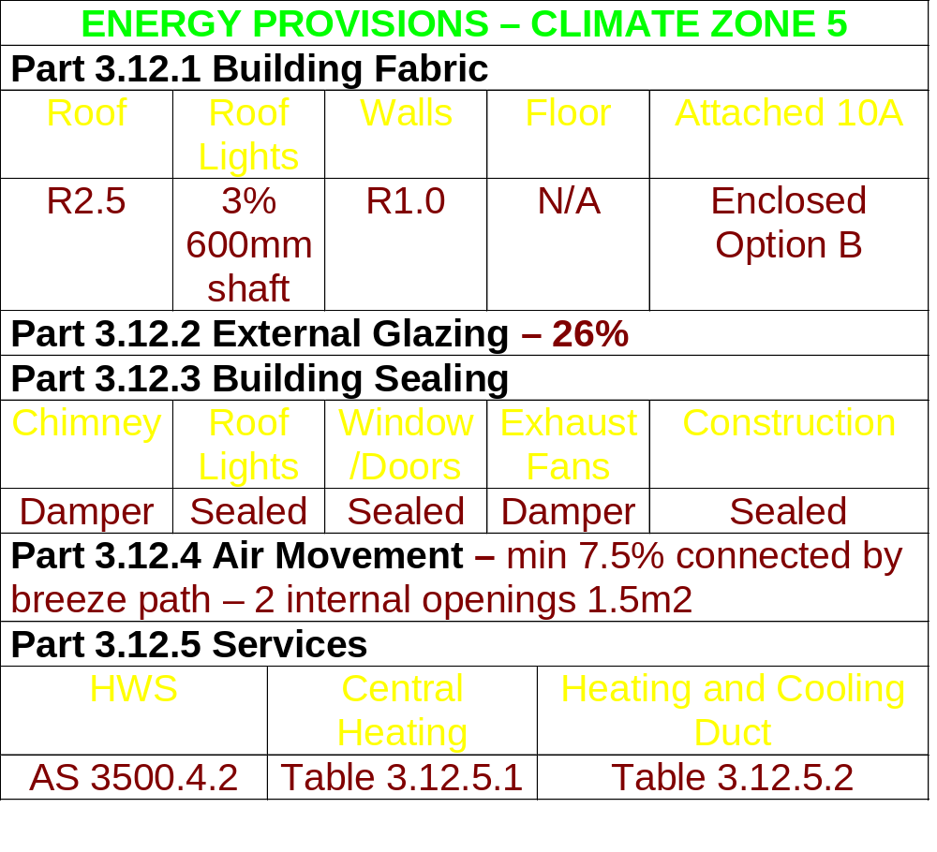
Energy Provisions Table

Slide 37
Objective
Functional Statement
Performance Requirements
Deemed-To-Satisfy Provisions
Alternative Solutions
Expert opinion
Verification Method
Documentary evidence
Comparison with a Deemed-To-Satisfy Provision
Notes:
Performance Requirements
In simple terms, the Performance Requirements of the BCA are the mandatory provisions of the BCA.
The Performance Requirements only specify what is required in order to comply with the BCA - but don’t require any particular method to be used to achieve compliance.
The general concept of having performance based building regulations is to provide flexibility to practitioners, who may know equal or better methods of achieving the required outcomes.
Detailed Methods of Verification
The BCA contains various methods that can be used, however all these methods are optional. One method is to simply follow the Deemed-to-Satisfy Provisions. . However other suitable methods can be developed as Alternative Solutions.
Deemed-to-Satisfy Provisions
Deemed-to-Satisfy Provisions are methods of design and construction that have been deemed by the ABCB to be acceptable methods of achieving compliance with the mandatory Performance Requirements.
In the Housing Provisions of the BCA (ie. Volume 2) Deemed-to-Satisfy Provisions are referred to as either acceptable construction manuals or acceptable construction practice.
The main benefit of following these methods is that the resulting construction must be accepted by the approval authority as complying with the BCA.
However, it should be noted that practitioners do not have to follow the Deemed-to-Satisfy Provisions and are allowed to develop their own Alternative Solutions.
Verification Methods
Verification methods are processes that can be used by practitioners as a means of verifying that a particular Alternative Solution complies with the relevant Performance Requirement of the BCA. The BCA presents two specific Verification Methods for Alternative Solutions to the Deemed-to-Satisfy Provisions for energy efficiency.
However, should an Alternative Solution not comply with either of these methods then the practitioner can still attempt to have their Alternative Solution accepted by the approval authority by using one of the forms of evidence listed in Clause 1.2.2 of the BCA. If these processes fail, there is generally an appeal process available within State or Territory administrative legislation.
Alternative Solutions
The BCA recognises that there may be many ways in which compliance with the mandatory Performance Requirements can be achieved. As the BCA cannot describe all possible ways, it allows practitioners to develop their own method of compliance. However, it also places the onus upon the practitioner to demonstrate compliance to the approval authority. Clause 1.0.9 lists several ways in which compliance may be demonstrated and clause 1.2.2 lists several forms of documentary evidence that can be used by practitioners. It is generally recommended that practitioners who contemplate developing an Alternative Solution, discuss their proposals with the approval authority to ensure that these can be accepted.

Slide 38

Software Information
Should you wish to purchase the software, please contact SEDO for details. The cost is $300, inclusive of GST and postage.
To obtain a free demonstration copy, visit www.seav.vic.gov.au.
Contact Details
The FirstRate Program Officer – (08) 9420 5664
Sustainable Energy Development Office
Level 9 Governor Stirling Tower
197 St Georges Terrace PERTH WA 6000
Notes:
The base case is a lightweight insulated house without windows and scores 0 points in each climate. That is why the point scores to get the various stars vary between climates as the base case house is better suited to some climates than others.

Slide 39
USEFUL WEB-SITES
www.buildingonline.com.au
www.abcb.com.au
www.seav.vic.gov.au
www.sedo.energy.wa.gov.au
www.dlgrd.wa.gov.au
www.greenhouse.gov.au

